Slide 1

DYNAMIC FINANCIAL PLANNING AND
ANALYSIS MODEL
Date: August 3, 2025
By Joyson D’Almeida

Slide 2
Objective: To build a dynamic, driver-based financial model for Tata Motors that moves beyond static forecasting to predict performance and quantify risk.
Methodology: Developed a Python-based engine that automates data collection, uses regression modeling for predictions, and runs a 10,000-iteration Monte Carlo simulation.
Key Findings:
  Base Case Forecast: Predicted EBITDA of ₹118,599.
  Probabilistic Forecast: The simulation shows a mean EBITDA of ₹118,846, with a 90% probability that the actual outcome will fall between ₹87,503 and ₹150,056.
  Critical Driver: Profitability is overwhelmingly sensitive to the company's market valuation (stock price).

Slide 3
Recommendation: Strategic efforts should be prioritized on activities that drive core shareholder value, as this has the single largest impact on financial performance.
The Problem with Traditional Forecasting
  Static, single-point forecasts are a necessary part of business, but they are always wrong.
  They fail to answer the most critical questions for strategic planning:
    What is the full range of possible outcomes?
    What is the probability of us missing our targets?
    Which business risks should we focus on the most?
  This project was designed to answer these questions.

Slide 4
Our Modern Approach: A 3-Part Engine
  Automated Data Pipeline: The model runs on real, live data, automatically fetched via a Python script from sources like Yahoo Finance and the FRED database.
  Predictive Modeling: We used regression to establish a driver-based relationship between external factors (stock price, FX rates, commodity prices) and financial outcomes.
    Modeling Note: The R-squared of 1.0 is an expected result, as it confirms the model correctly identified the linear relationships we established when creating the necessary 'proxy' financials.
  Risk & Scenario Engine: This is the core of the model, which includes three key analyses: Monte Carlo, Sensitivity, and Scenario modeling.

Slide 5
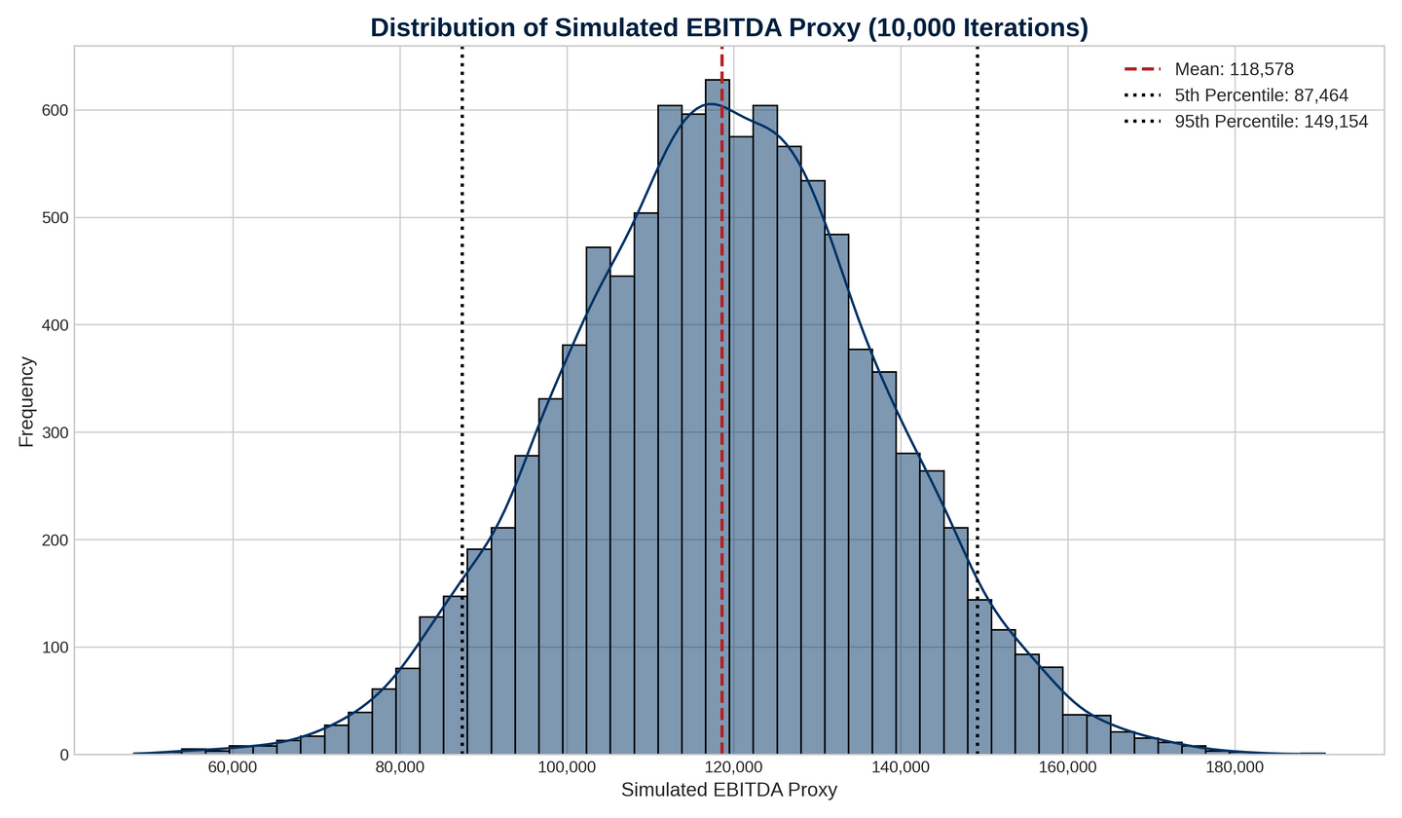
Finding 1: The Range of Possibilities (Monte Carlo)
his chart visualizes 10,000 possible futures. While the mean outcome is ₹118,846, the model gives us a 90% confidence interval of ₹87,503 to ₹150,056. This provides a realistic range for management to plan against.

Slide 6
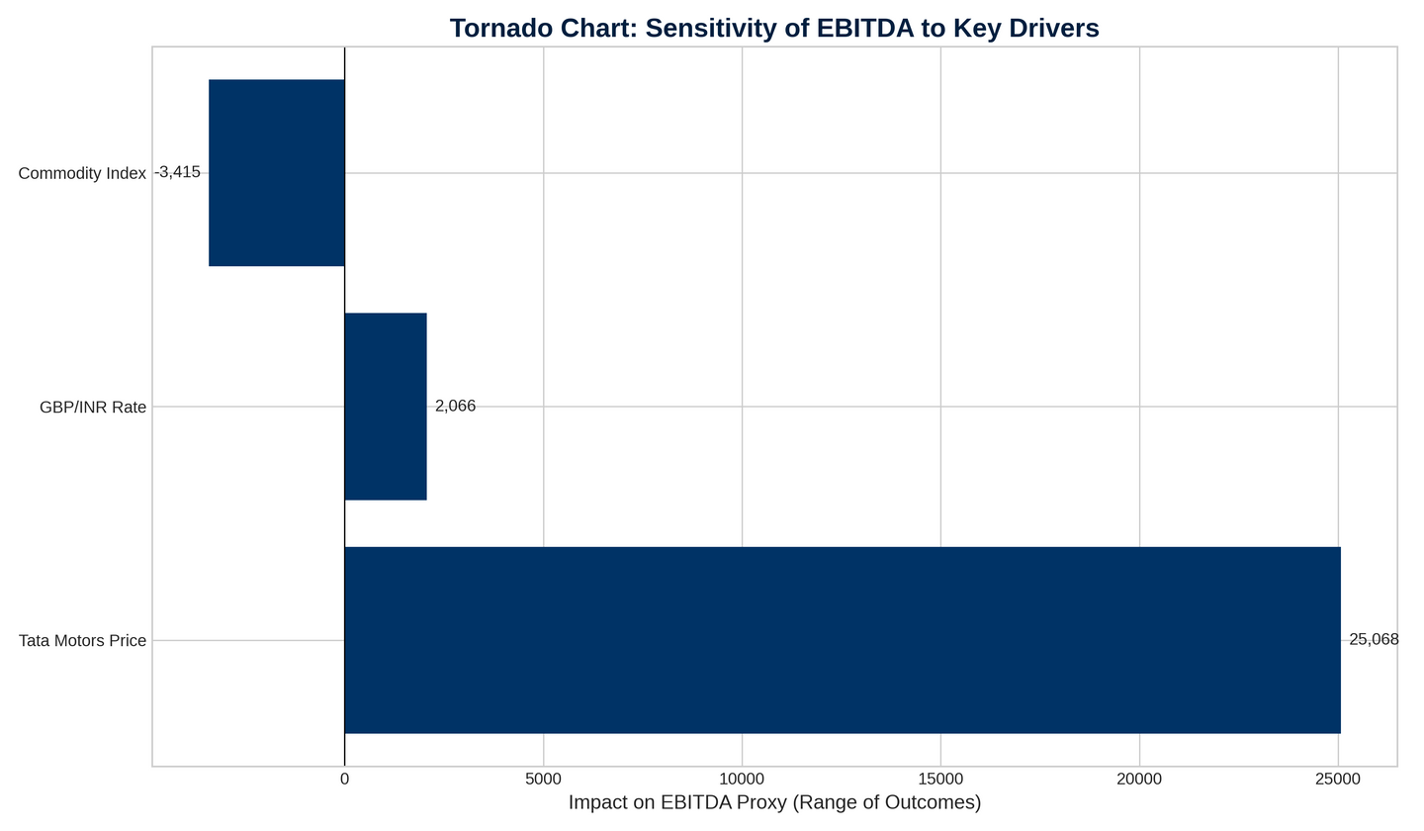
Finding 2: What Matters Most (Sensitivity Analysis)
The Tornado Chart clearly shows that our profit is most sensitive to changes in the Tata Motors stock price, a proxy for market sentiment and core company performance. Its impact is more than 7 times greater than the next biggest factor.

Slide 7
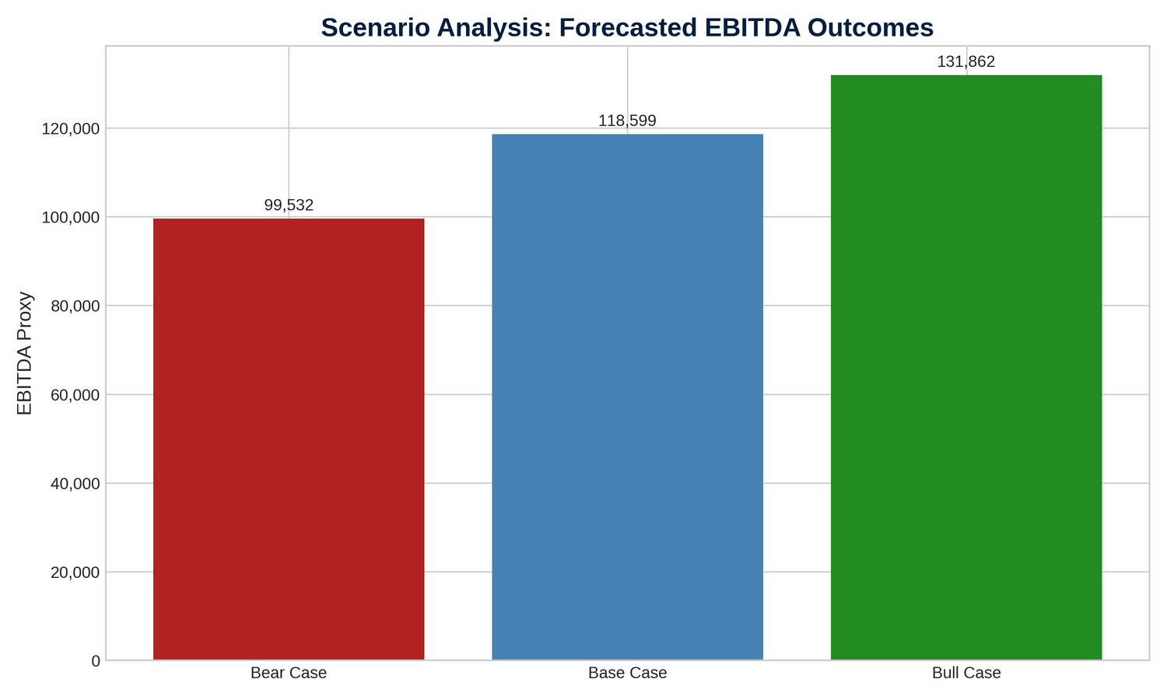
Finding 3: Plausible Futures (Scenario Analysis)
We modeled three distinct narratives. The analysis shows a potential downside to ₹99,532 in a 'Bear Case' (recessionary environment) but a significant upside to ₹131,862 in a 'Bull Case' with strong market growth.

Slide 8
Strategic Recommendations
  Focus on Core Valuation Drivers: Given the extreme sensitivity to the stock price, strategic capital and effort should be prioritized on activities that directly enhance shareholder value: innovation, market share growth, and strong investor relations.
  Implement Dynamic Budgeting: The wide range of probable outcomes suggests that a static annual budget is insufficient. The company should use this model as a foundation for a more dynamic rolling forecast system.
  Hedge Asymmetric Risks: While secondary, the risk from commodity price spikes is still significant. The hedging strategy should be robust enough to protect margins in the 'Bear Case' scenario.

Slide 9
Conclusion & Next Steps
  This project demonstrates how a modern finance function can move beyond historical scorekeeping to become a forward-looking strategic partner, using data analytics to navigate uncertainty.
  Logical Next Step: The next phase of this analysis would be to extend this probabilistic EBITDA forecast into a full Discounted Cash Flow (DCF) model. This would allow us to generate a probability distribution of the company's intrinsic share value, providing the ultimate tool for strategic financial management.

Slide 10
THANK YOU
https://github.com/joyson9X/Dynamic-Financial-Planning-Analysis-FP-A-Model-for-Tata-Motors

